Slide 1
README
BURN AFTER READING
about_SlideDeck
The actual presentation starts with slide 6 ("Session title"). The first five slides have a purely organisational purpose. During the break before your session, you should start the presentation with slide 2 ("Next up"), so that the audience knows that they are in the right room. It's fine if you start chatting with the audience during this break, but we need a precise starting point for your presentation in terms of editing your video. That means:
The recording of your presentation will start after the countdown. Please (RE)START talking after the countdown, not during it! Otherwise your recording will start with a half sentence.
It is not necessary to explicitly signal to the PA operator, this is your signal!
Finally, do you have to use this slide deck? No, you are free to present the way you like it. But you are asked to use the intro slides: countdown, session title, sponsor slide. Beyond that, use what is good for the cause – from no slides to sketches from your children, from Jupyter to $youNameIt.
You will find additional information in the notes below.
Sincerely, your hosts!
Dear Speaker, we are thrilled and honored to have you with us in Malmö in 2025. Take your time and read this before you prepare your session.
Since most of you have been with us before, you will already know a lot about PSConfEU. You know that we try to capture all sessions carefully and publish your work on YouTube. There are a few easily avoidable stumbling blocks that we would like to draw your attention to:
Your screen resolution should be 1920x1080 px (FullHD)
You should provide a full size HDMI socket
Mirror your screen
Disable "Presenter View" in PowerPoint
Using MAC or Surface book? Be aware of HDCP!
Disable the ‘Night Light Mode’
Notes:
The fine print (additional information)
Why should you care about HDCP?
"High-bandwidth Digital Content Protection (HDCP) is a form of digital copy protection developed by Intel Corporation to prevent copying of digital audio and video content as it travels across connections. Types of connections include DisplayPort (DP), Digital Visual Interface (DVI), and High-Definition Multimedia Interface (HDMI), as well as less popular or now deprecated protocols like Gigabit Video Interface (GVIF) and Unified Display Interface (UDI)."
https://en.wikipedia.org/wiki/High-bandwidth_Digital_Content_Protection
Some notebooks ignore the HDCP standard, some vendors comply with the standard. Apple and Microsoft are somehow famous for strictly following the HDCP guidelines. Sadly, we will not be able to guarantee, that your session can be recorded in the latter case.
But you can do simple things, to overcome these problems. It is also very likely that you presented with your notebook before. So you will know, if this worked fine.If you are in doubt and if the agenda allows, try a dry-run a day before and connect everything.
In general you can easily bypass HDCP restrictions with a cheap splitter (the cheaper the better), just like the one you see below. This is an example device that we bought for 16 euros (in Germany).
Ask us, we will lend you such a device.
Thorsten also gave a whole presentation about "Broadcasting yourself" - easy steps to record yourself and create a (backup) session recording on your own. If you want to invest your time and dive deeper, take a look at his recordings and notes:
https://vimeo.com/thorstenbutz/byourself
This is of course completely voluntary, but perhaps you will find it helpful.

Slide 2
Next Up:
Leo Visser

Slide 3
3
3

Slide 4
2

Slide 5
1

Slide 6
Use PowerShell to make automations more sustainable
Leo Visser

Slide 7

Many thanks to our sponsors:

Slide 8
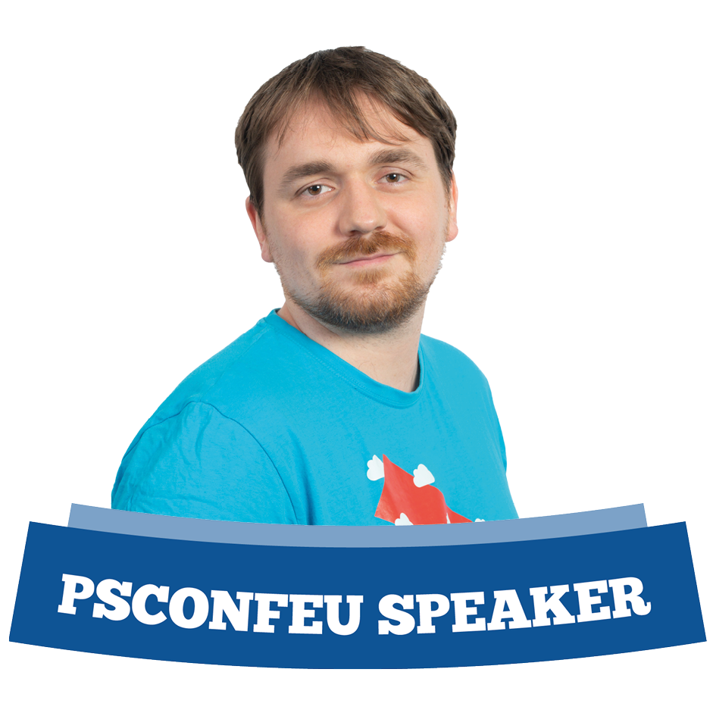

Leo Visser
Cloud Consultant @ OGD
Product Owner Automation & AI @ OGD
Microsoft MVP
Microsoft MCT
Blog: www.autosysops.com
Notes:
Small intro 2 (2)

Slide 9
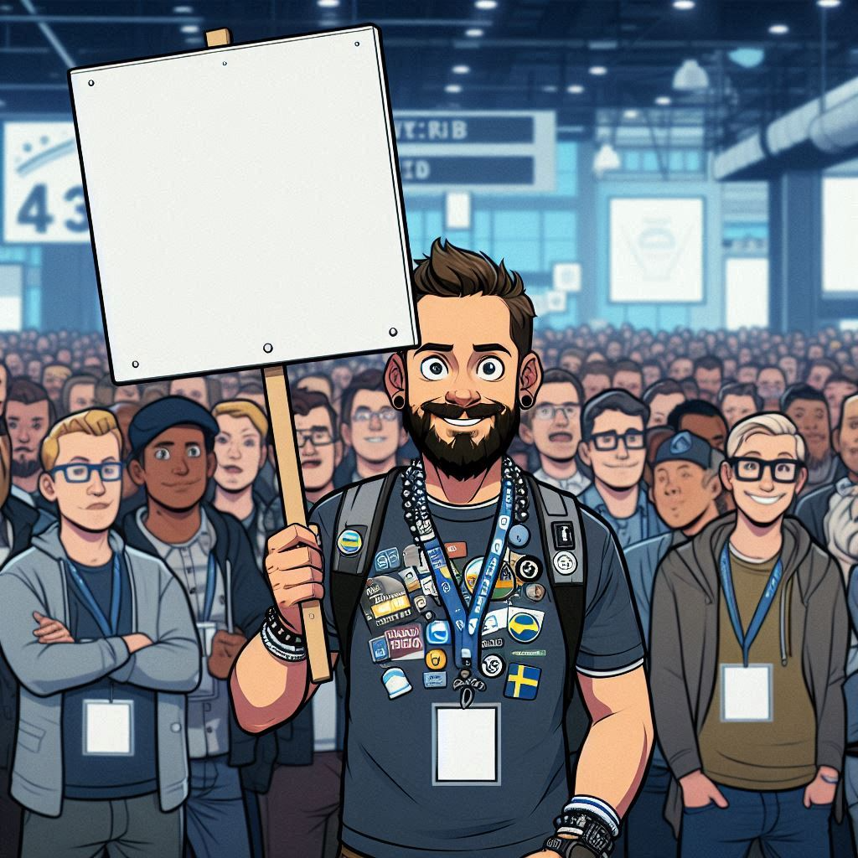
What’s today about?
Why sustainability?
Sustainable code
Data available
Sharing of idea’s
Future idea’s
I don’t offer a full solution. I want help!
Notes:
Small outline of talk and explanation I offer suggestions here and hope the community will help. 3 (5)

Slide 10

Sustainability?
Many areas to improve
Long journey still
Look for opportunities
https://sdgs.un.org/goals
Notes:
Explanation that sustainability is more then just carbon emissions 3 (8)

Slide 11
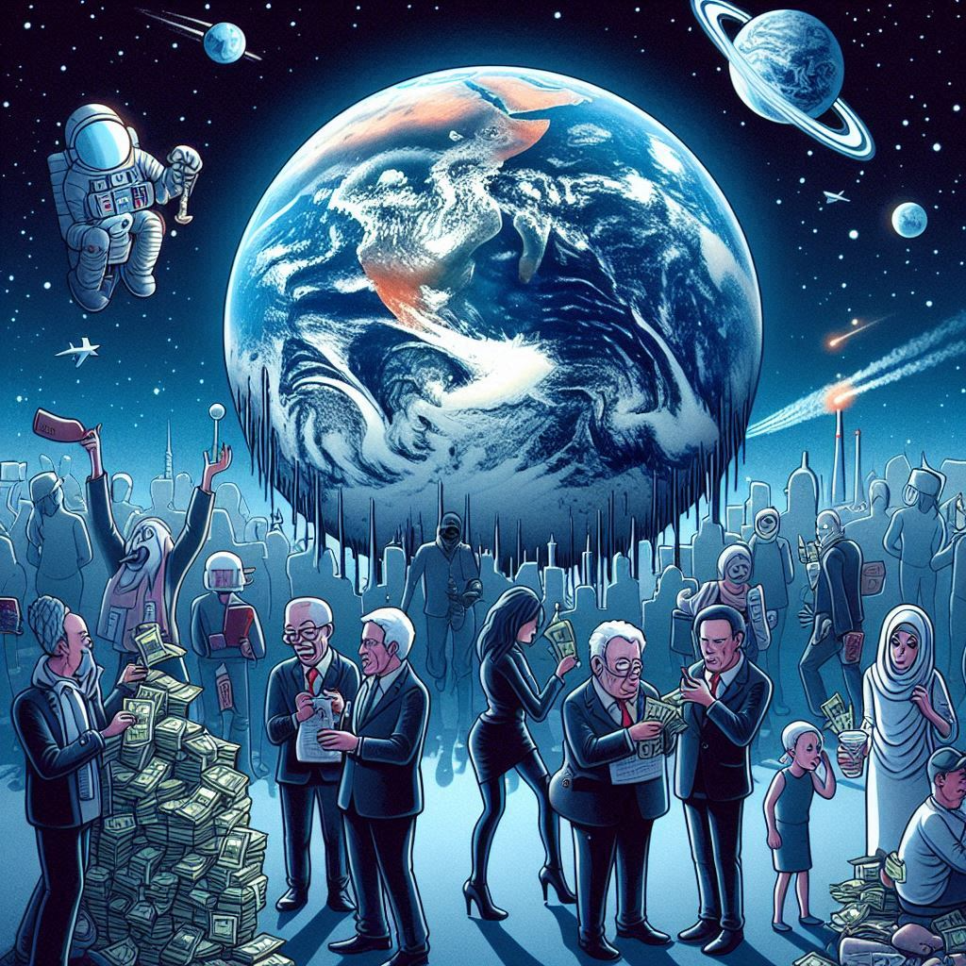
Why sustainability?
Climate is impacted by emissions
IT is a significant factor
Hard to sell to corporate
Corporate Sustainability Reporting Directive (CSRD)
Carbon offsets are a market so, with rising demand ….
Notes:
Explain impact of IT to climate, hard sell as it doesn’t make money. CSRD will become an issue soon(ish) and carbon offsets are a market so they will only rise in price. 4 (12)

Slide 12
Sustainable Code
CPU cycles spend energy, so limit them.
Notes:
Tell a bit about sustainable code and how to improve it. 2 (14)

Slide 13
Demos
We love Demos!
Notes:
Let’s fix some code! 9 (23)

Slide 14
Sustainable Code
CPU cycles spend energy, so limit them.
Check your loops and end them when done.
Use batching when passing items to heavy processes
Be careful with your API calls
Implement Caching options
Use tools like profiler to improve your code
Notes:
Explain concepts some more 2 (25)

Slide 15
Sustainable Code
What are you running it on?
Always-on infrastructure?
Share infrastructure?
Notes:
Explain shared infra gives better use of the hardware as idle time still consumes energy. 2 (27)

Slide 16
Data available
Carbon Data Initiative (www.carbondi.com)
Electricity maps (www.electricitymaps.com)
Cloud Carbon Footprint (www.cloudcarbonfootprint.org)
Entsoe (https://transparency.entsoe.eu)
Notes:
Cover some of the other tools available 6 (33)

Slide 17
Demos
We love Demos!
Notes:
Show website and new platform 10 (43)

Slide 18
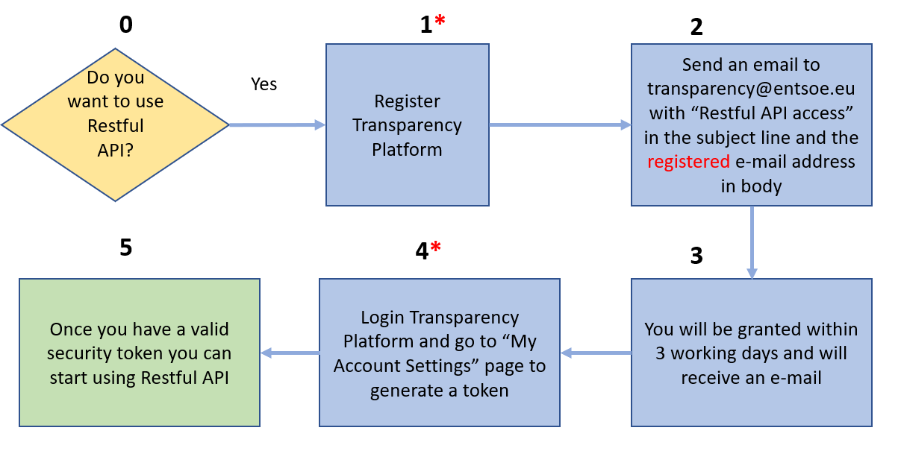
Data available - Entsoe
API Keys available (via manual review)
https://transparencyplatform.zendesk.com/hc/en-us/articles/12845911031188-How-to-get-security-token
Notes:
Talk short about gaining access 2 (45)

Slide 19
Data available - Entsoe
Postman library available https://documenter.getpostman.com/view/7009892/2s93JtP3F6
Most enum explained
Notes:
Talk short about the enums and the postman library 2 (47)

Slide 20
Demos
We love Demos!
Notes:
Show the postman libraries 5 (52)

Slide 21
Sharing ideas
Schedule an automation based on green/fossil energy available
Notes:
Explain the concept of the automation 1 (53)

Slide 22
Demos
We love Demos!
Notes:
Run through the whole automation of the script 17 (70)

Slide 23
Sharing ideas
Schedule an automation based on green/fossil energy available
Move a resource based on where green/fossil energy is best
Notes:
Explain the concept of the automation 2 (72)

Slide 24
Demos
We love Demos!
Notes:
Run through the whole automation of the script, Don’t forget to explain queueing of jobs with for example Azure DevOps 10 (82)

Slide 25
Sharing ideas
Non-HA resources can work with queues like Azure DevOps
HA resources can utilize Global Load Balancer in Azure https://learn.microsoft.com/en-us/azure/load-balancer/cross-region-overview
Same techniques can be applied for cost instead of energy too
Notes:
Explain HA/non-HA and using it for costs 3 (85)

Slide 26
Future ideas
Create a full featured PowerShell module for entsoe (if you want to help contact me!)
Convince Microsoft to publish more data about PUE of datacenter like they used to do.
Find out more about underlying hardware and efficiency of that hardware
Schedule based on load on network instead of green/fossil balance
Notes:
Explain future ideas 5 (90)

Slide 27
Q&A
15 minutes

